Slide 1
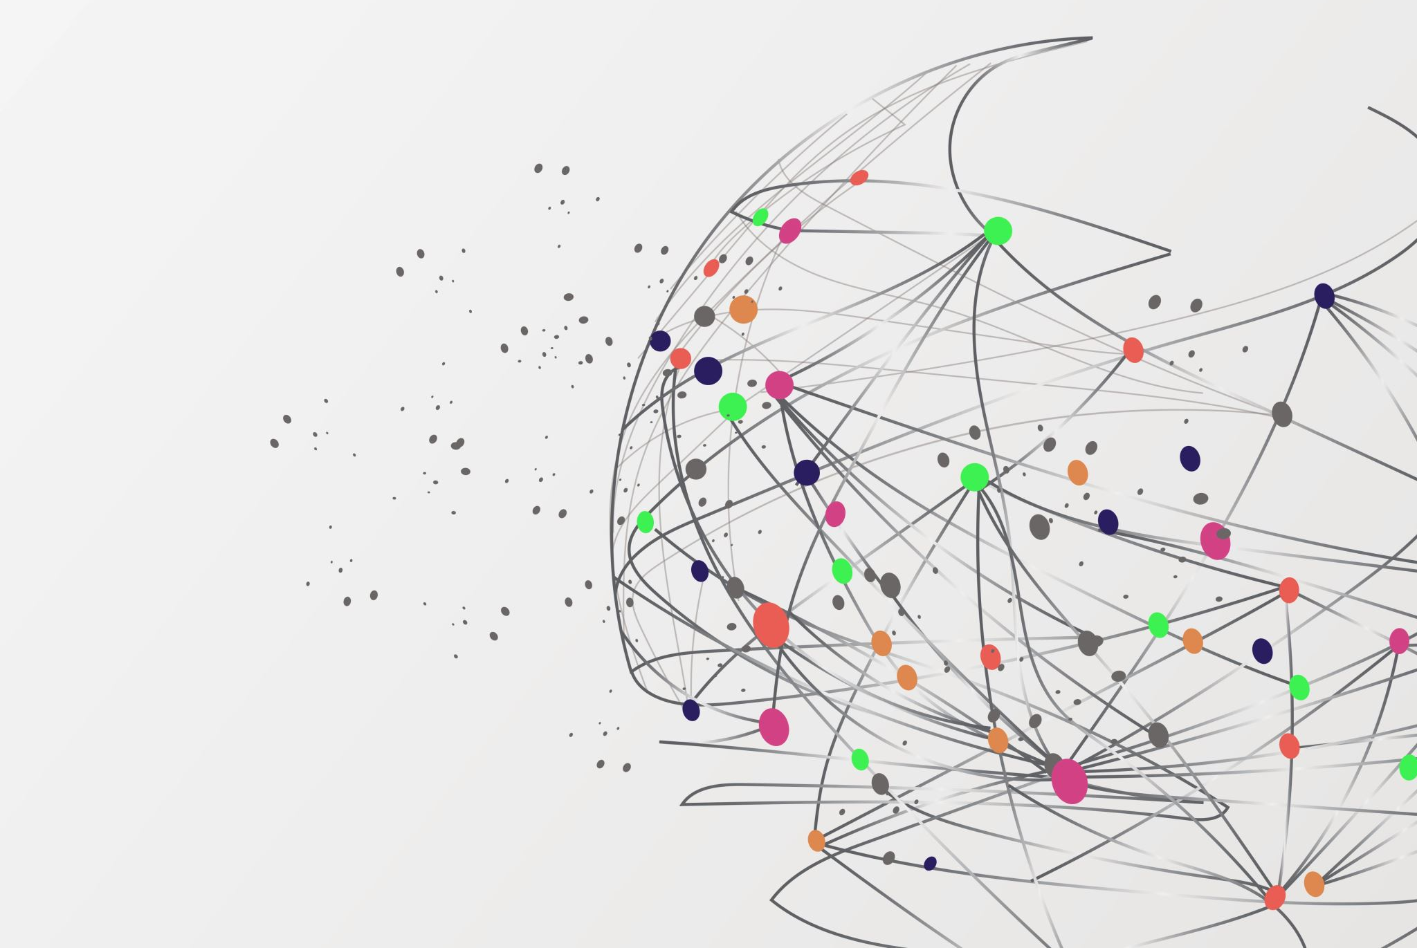
Fraud detection and analysis
By Dhruv Nair

Slide 2
Contents
Digital Fraud
The bane of digital banking
Fraud analytics
Case Study
Demo

Slide 3
Digital Fraud
Digital revolution has enabled banking transition from branch to branch based delivery to multiple online services
Empowering customers to access these services whenever and wherever
Customers are also now a vulnerability
Poor awareness
Notes:
https://www.sas.com/en_us/insights/fraud/fraud-prevention.html

Slide 4
Flaws of digital banking
Large amounts of digital transitions
Impossible to monitor manually
Open banking market
Need not log in directly
Third party initiates payment through an API
Less data to judge the authenticity of a transaction
Banks now rely on profiles/behaviors of customers
Notes:
https://www.sas.com/en_us/insights/fraud/fraud-prevention.html
THE $951M RAID ON BANGLADESH’S CENTRAL BANK
In early 2016, a criminal gang penetrated the security systems of Bangladesh Bank with malware that cloned legitimate transactions. On February 4, the malware sent 35 withdrawal requests through the international SWIFT system to the New York Federal Reserve, where the Bangladeshi central bank had money on deposit. The fraudsters attempted to steal a total of $951m. Thirty of the orders, worth $850m, were blocked by the New York Fed, but the gang succeeded in having $101m transferred to banks in Sri Lanka and the Philippines before their activities were noticed, thanks to a spelling mistake in one of the transfer requests. Subsequently, $20m was recovered from a Sri Lankan bank, but officials were too late to stop the remaining $81m from disappearing.

Slide 5
Types of Fraud
Social engineering
Phishing scams
Identity theft
Malware
Software flaws
Backdoors
Malware/ransomware
Notes:
https://www.sas.com/en_us/insights/fraud/fraud-prevention.html
Many phishing-type scams now involve significant elements of ‘social engineering’, in which the criminals use information gleaned from their victims’ social media profile, pose as officials to phone victims and check their personal details, and even intercept their mail to build a profile of the victim that will allow the fraudster to impersonate them. The information gained may be used to create lists of possible passwords that can be used in attempts to crack their online accounts. However, it can also be used to steal the victim’s identity and make fraudulent applications for financial products.
Rogue software is another favorite tool of fraudsters, who infect customers’ devices with worms and malware that recognize when they are signing into online banking services and log their keystrokes, enabling the criminals to steal their passwords.

Slide 6
Analytics
Creating a model which
Incorporates a detailed behavioral profile
Compared with every transaction to learn and test new features
Applying Machine learning
Creating a detailed profile based on historical data
Contains a wide variety of variables
Computes the probability
Based on the identified pattern
Notes:
This technique is applied both to individual customers and to institutional accounts that have multiple authorized users. The profile that the system creates becomes part of the template against which every future digital banking transaction is correlated to assess whether it matches the customer’s established patterns of behavior.
This behavioral information is augmented by a wide range of contextual information covering variables such as the customer’s geolocation, time of day, week and month, the device, web browser and type of webpage that is being viewed, the type of account involved (individual or institutional, for example), the domestic or international destination of any payments, whether the payee is new or previously known, and so on.

Slide 7
Analytics
Done through a number of methods, which mostly involves predictive and standard analytics.
Using analytic technology to detect potential cases
Either before the transaction is completed or after it
Gathering and storing relevant data to identify the patterns
Most advanced anti-fraud systems employ Big-data technology
Notes:
These days, nearly everyone engaged in fraud leaves behind a trail of digital fingerprints. This presents a big opportunity for companies to prevent further harm—but it’s often only considered after the damage has been done. Leaders in fraud prevention are taking advantage of new tools and technologies to harness their data to sniff out instances of fraud, potentially before they fully unfold
Better-tuned and more sensitive systems, in turn, will allow banks to strike a better balance between detecting fraud and allowing customers to carry out their transactions unhindered
Those banks that implement them can expect lower percentages of false positives, lower losses to fraud, improved customer service and less time wasted on compliance and verification to investigate false positives.
https://netguardians.ch/digital-banking-fraud/#chapter01

Slide 8
Case Study - 1
You are employed to help a credit card company to detect potential fraud cases so that the customers are not charged for the items they did not purchase.
Our goal is to use different classification models to distinguish these fraud transactions

Slide 9
Case study - 2
The dataset contains transactions made by credit cards in September 2013 by European cardholders.
This dataset presents transactions that occurred in two days, where we have 492 frauds out of 284,807 transactions. The dataset is highly unbalanced, the positive class (frauds) account for 0.172% of all transactions.
Feature 'Class' is the response variable and it takes value 1 in case of fraud and 0 otherwise.

